Slide 1
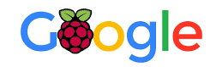
Raspberry Pi Google AI Assistant Using Push-to-talk Feature
Course Name:
EE-629A Internet of Things
Professor:
Prof. Kevin Lu
Team Members:
Rida Zainab
Raveena Mehta
Monami Mukhopadhyay

Slide 2
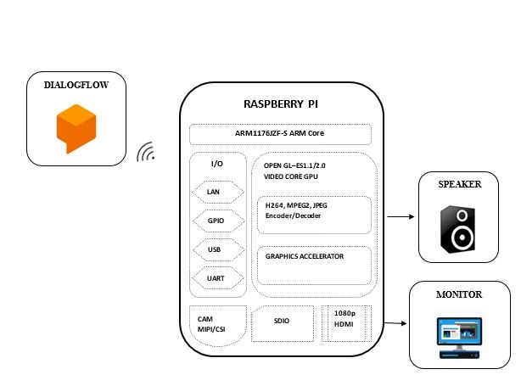
Project Abstract
Introduction:
The main aim of this project is to build a Raspberry Pi voice-controlled Google AI Assistant.
Google provides the API for using its voice service, which is open source.
Using Google voice service, we can play music, get information about weather, book tickets and many more. We just need to ask.
Application:
It’s the age of AI, and we all are swarmed away with the number of mesmerizing open-source AI projects getting in the market every day. They are one of the driving factors for business growth.

Slide 3
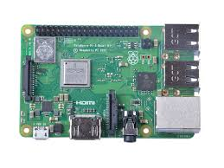
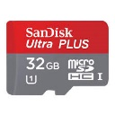
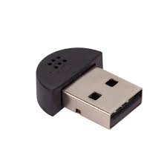
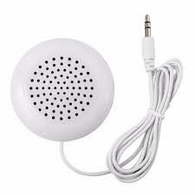
Pre-requisites
Our approach requires the below equipment list:
Raspberry Pi 3 Model
Micro SD card with Raspbian installed (or any other Debian-based distribution)
USB microphone
Speaker with 3.5mm connector

Slide 4
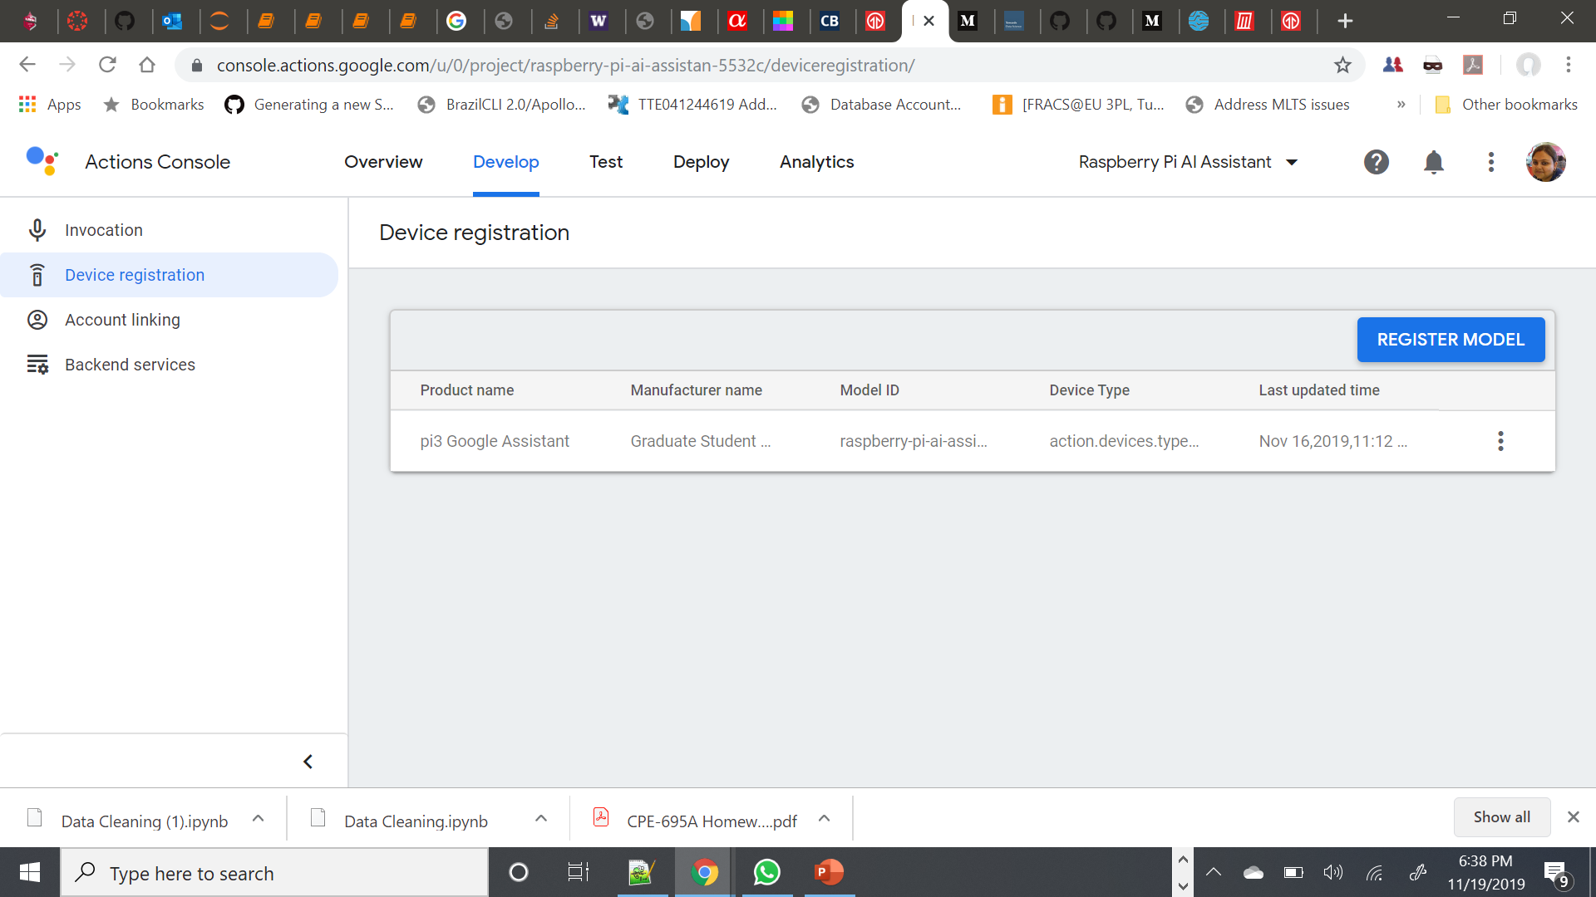
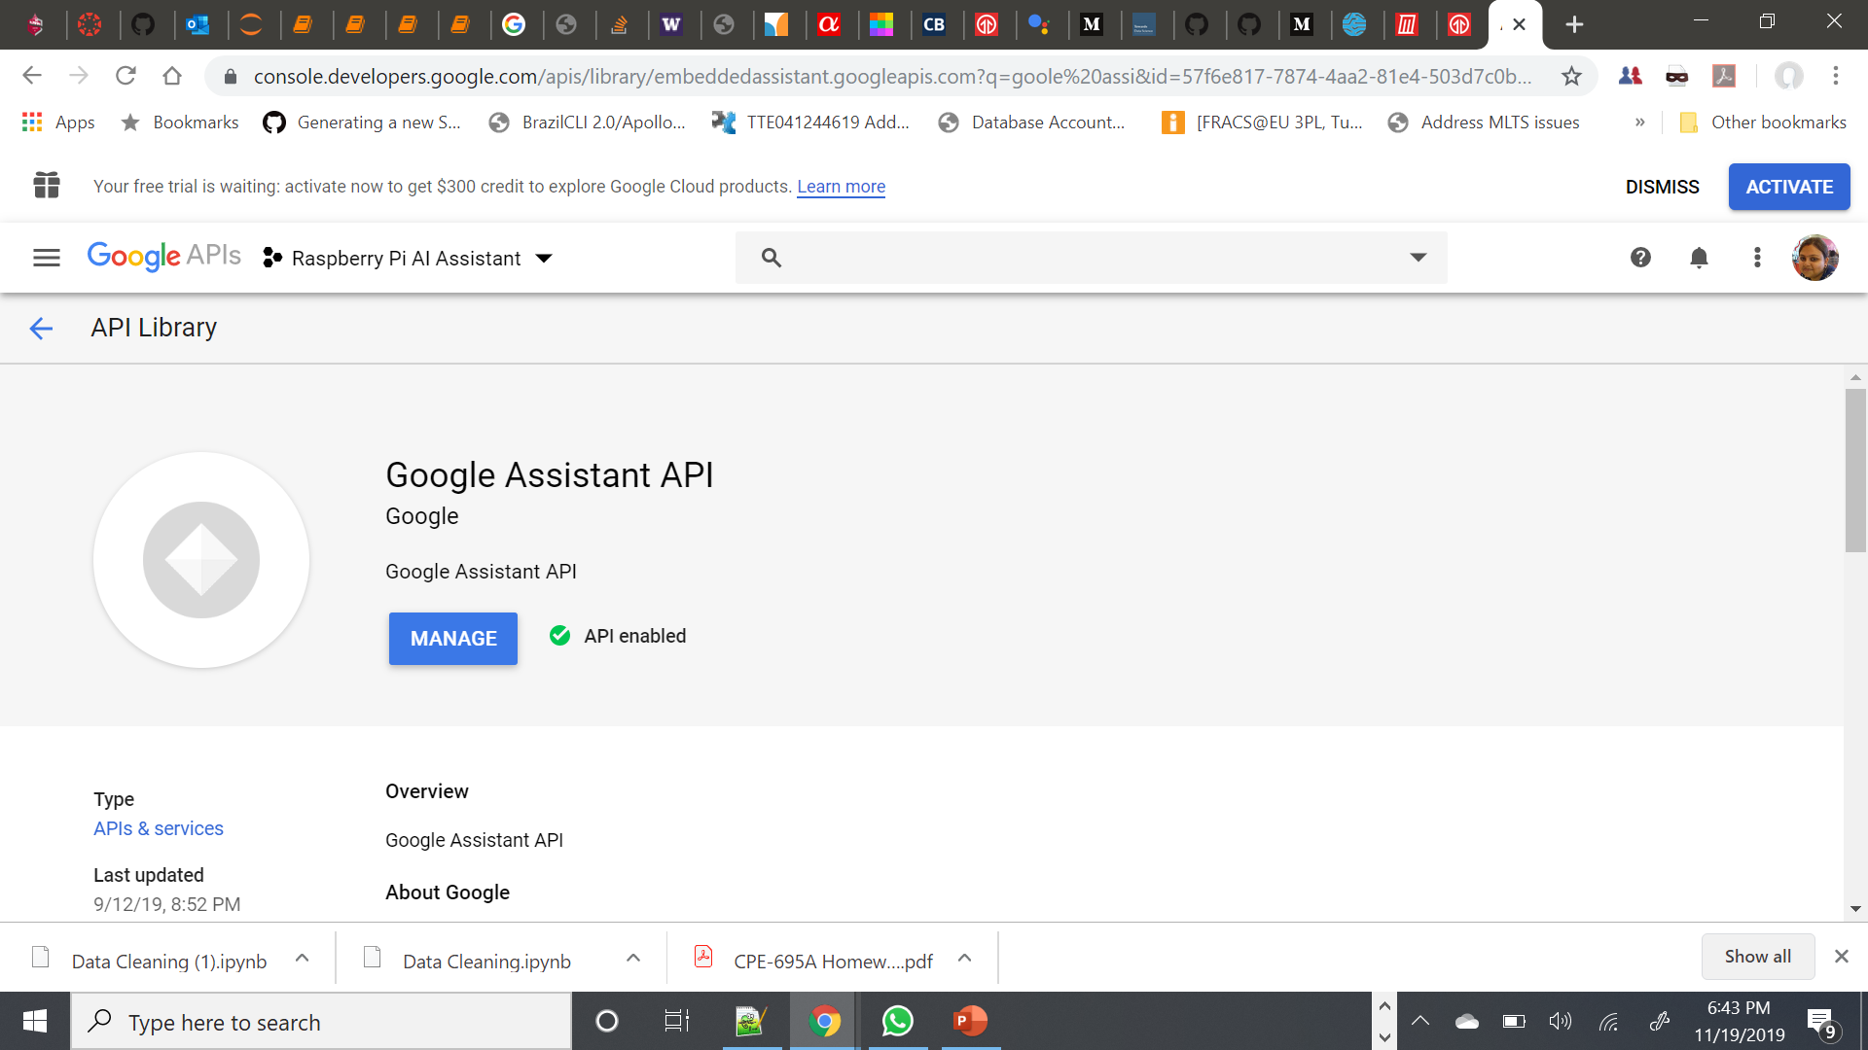
Registering for the Google API
We need to go to https://console.actions.google.com to register and set up project.
Next, we need to go to http://console.developers.google.com enable the Google Embedded Assistant API.
We also need to do Raspberry Pi device registration on Google platform. Once we have registered the model, we see the “Download credentials” screen. We need to save this credentials json file.
We also need to configure the OAuth consent screen, without this Google won’t let us authorize our Raspberry Pi Google Assistant device.

Slide 5
Setting up Audio for Google Assistant
We note down the device and card number for both USB Microphone and Speaker using below command.
arecord –l aplay -l
Once, the configuration is done, we can check if speaker and microphone are working properly using below command.
arecord --format=S16_LE --duration=5 --rate=16000 --file-type=raw out.raw
aplay --format=S16_LE --rate=16000 out.raw
<Insert recorded file>

Slide 6
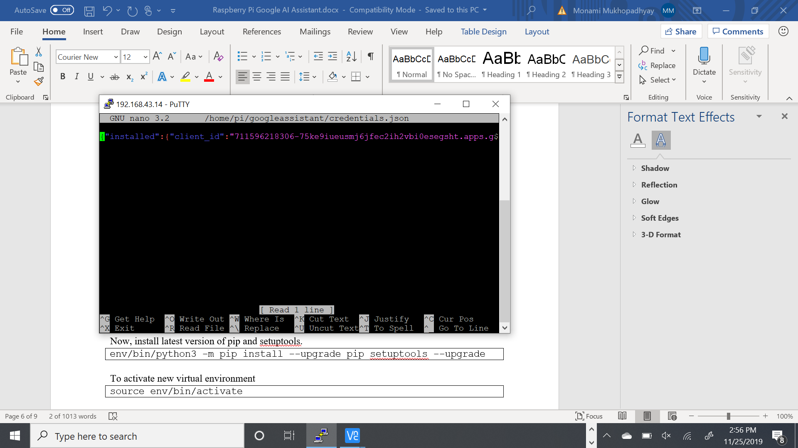
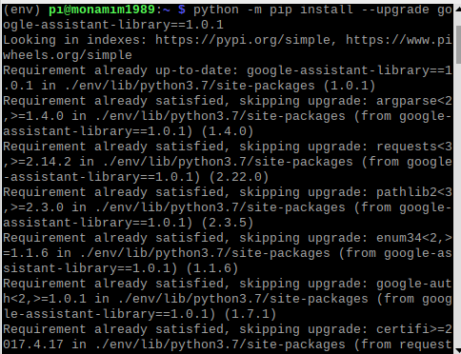
Downloading and Setting up Google Assistant
We first update the Raspberry Pi’s package list by running the following command.
sudo apt-get update
On your Raspberry Pi, we create a file where we will store the credentials we downloaded earlier on our computer.
mkdir ~/googleassistant
nano ~/googleassistant/credentials.json
Next, we run the following command to install Python3 and the Python 3 Virtual Environment to our Raspberry Pi.
sudo apt-get install python3-dev python3-venv libssl-dev libffi- dev libportaudio2
We can now enable Python3 on our virtual environment variable using this command.
python3 -m venv env
Now, install latest version of pip and setuptools.
env/bin/python3 -m pip install --upgrade pip setuptools –upgrade
To activate new virtual environment
source env/bin/activate
Now we can install the Google Assistant Library for Python
python3 -m pip install --upgrade google-assistant-library
python3 -m pip install --upgrade google-assistant-sdk[samples]

Slide 7
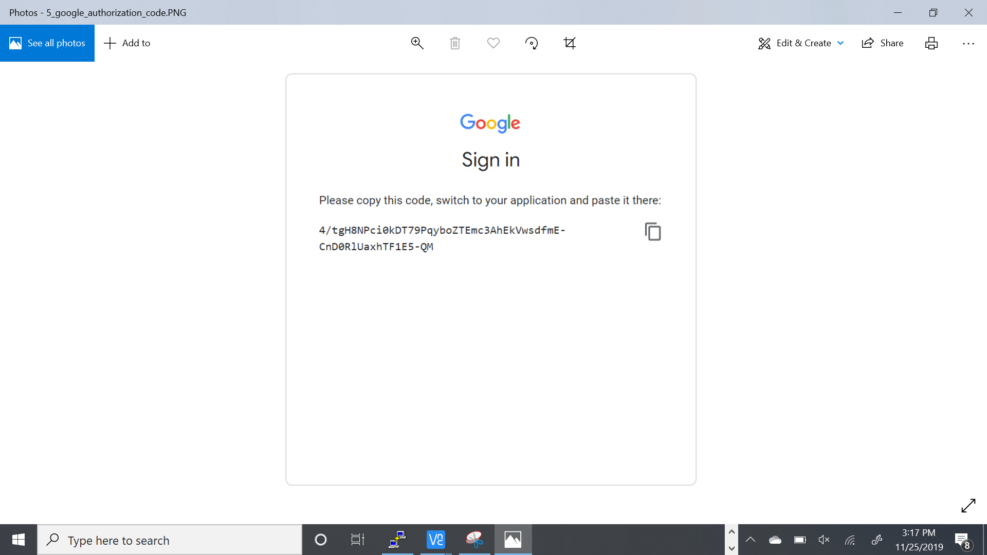
Authorizing the Pi for Google Assistant
For this, we need to install the authorization tool so that we can authorize the Google Assistant API.
python -m pip install --upgrade google-auth-oauthlib[tool]
Once the authentication library is installed, we need to run following command on Raspberry Pi. This step is very crucial.
google-oauthlib-tool --client-secrets ~/googleassistant/credentials.json \
--scope https://www.googleapis.com/auth/assistant-sdk-prototype \
--scope https://www.googleapis.com/auth/gcm \
--save --headless
This command will generate a URL. We need to copy this URL and open in web browser. From here, copy the authentication code and paste on the Pi terminal and press enter.
If authentication is accepted, we can see something like this.
“credentials saved: /home/pi/.config/google-oauthlib-tool/credentials.json”

Slide 8
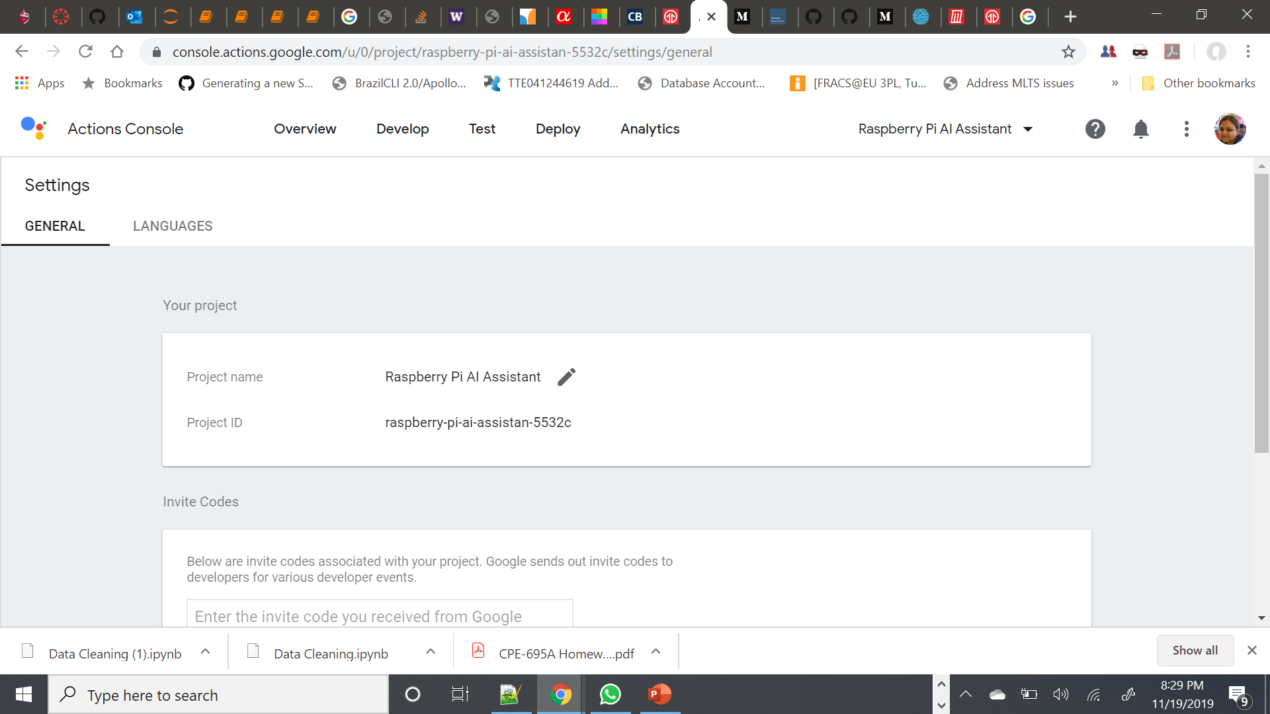
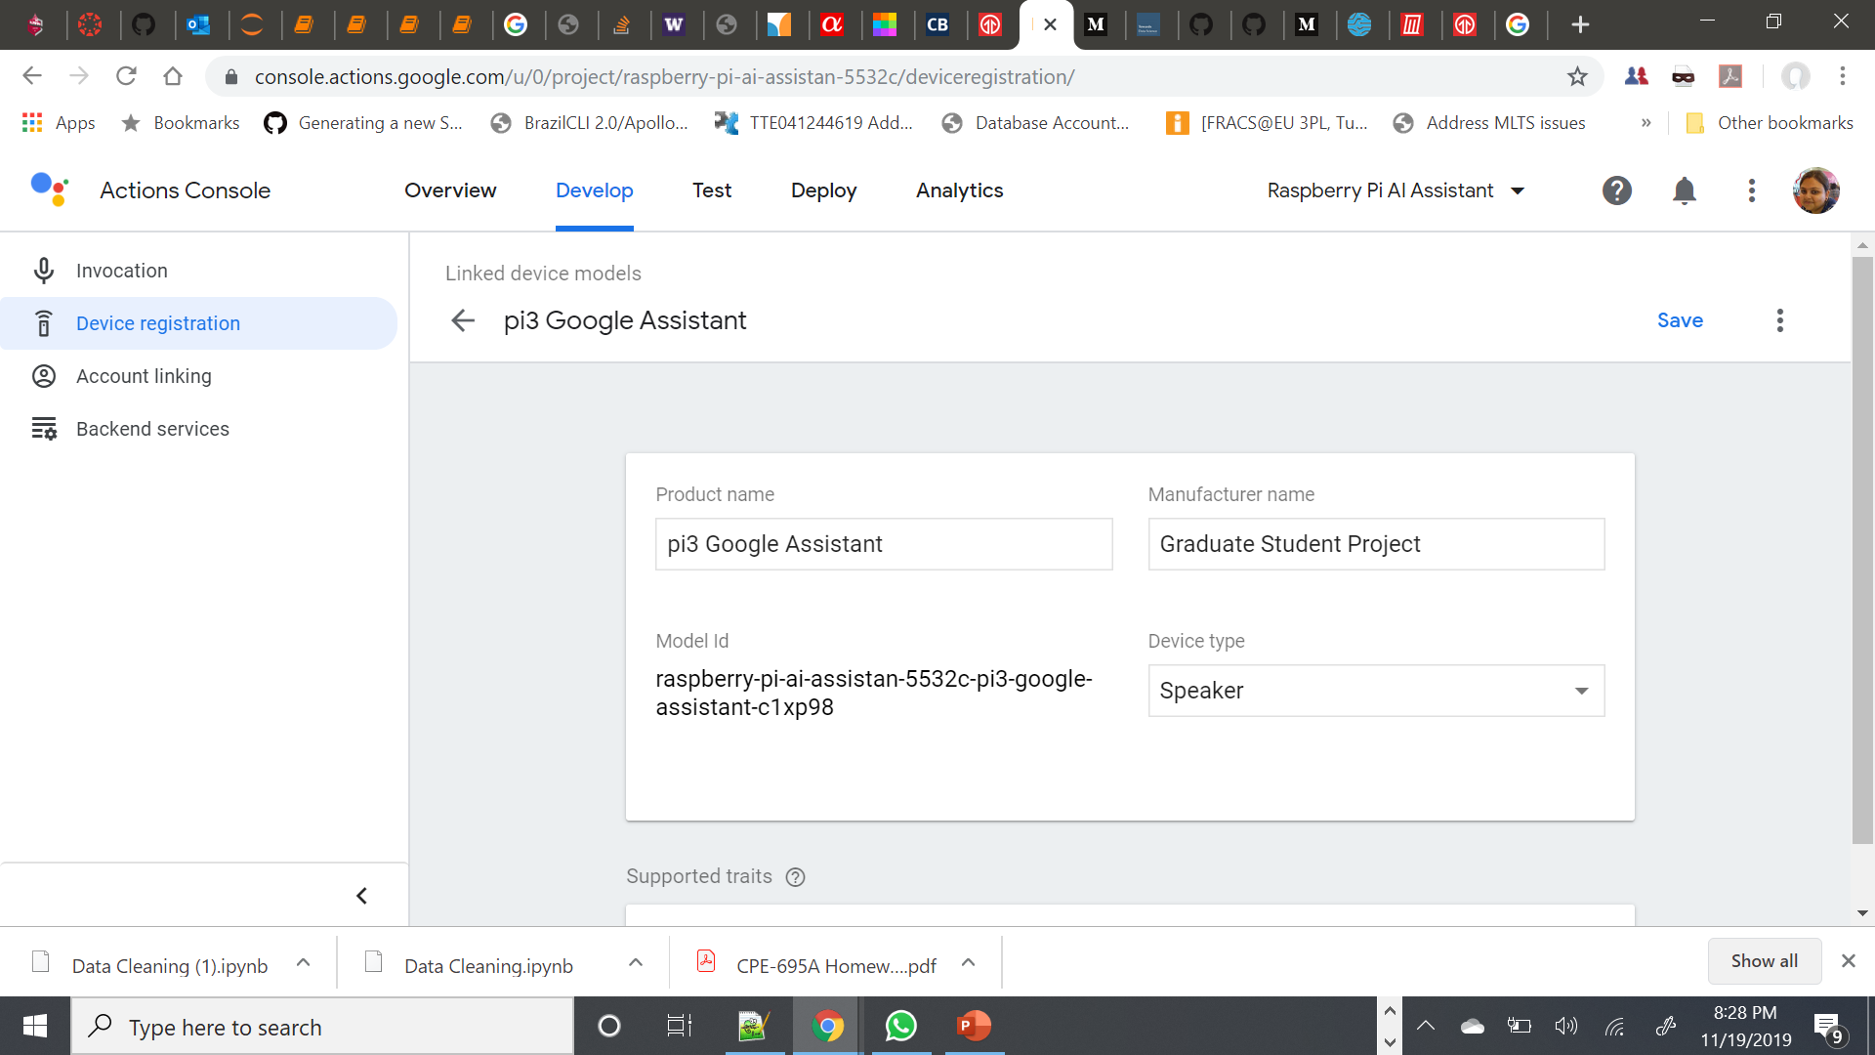
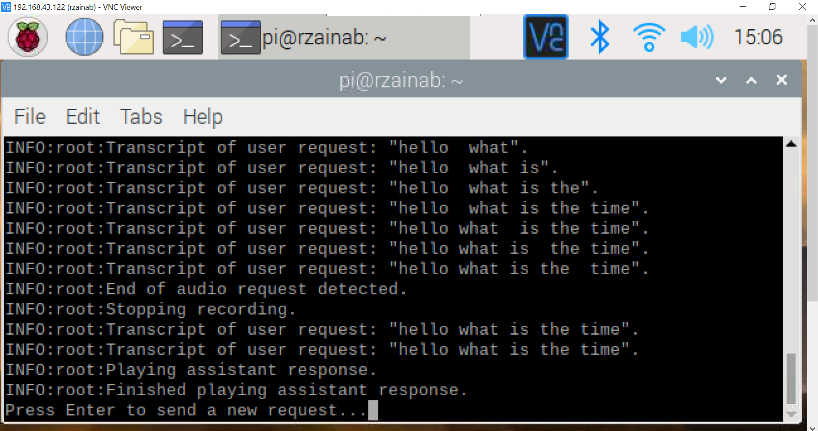
Run Google Assistant on Raspberry Pi
We need to obtain and note down our project id and device-model-id. We can check project id from ‘Project Settings’ inside https://console.actions.google.com and we can get device-model-id from ‘Device Registration’ inside https://console.actions.google.com
Using these data, we can type the following command to talk to Google Assistant.
googlesamples-assistant-pushtotalk --project-id <projectid> --device-model-id <deviceid>
We press ENTER and speak any action. For example – “What is the time and date now?” We will receive a verbal response from assistant.
We can do a similar approach with hotword (‘Ok google’ in this case). This sample code will work by listening for this hotword to trigger it, followed by the command that we want to issue to the assistant.
googlesamples-assistant-hotword --device-model-id <deviceid>
Finally, we have set up Raspberry Pi with the Google Assistant software.

Slide 9
Start Google Assistant on Startup
<Enter Snap Here>

Slide 10
Demo
<Enter Snap Here>

Slide 11
Result
<Enter Snap Here>

Slide 12

Individual Contribution
Each of the members had unique contributions towards the project. But there are areas where all three of us are working together as well.
Rida Zainab is responsible for preliminary research, gathering information, external materials to refer to, project evaluation and code testing.
Raveena Mehta is responsible for compiling all the modules, code testing, result extraction and documentation.
Monami Mukhopadhyay is responsible for code testing, result extraction, project compilation, documentation, gathering and implementing references and other resources.

Slide 13
Thank You!

